Slide 1

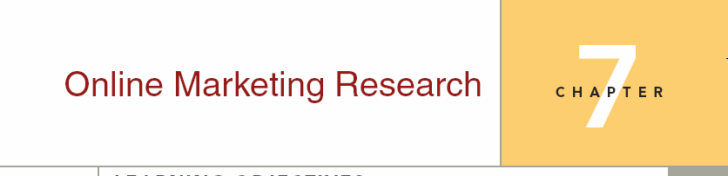
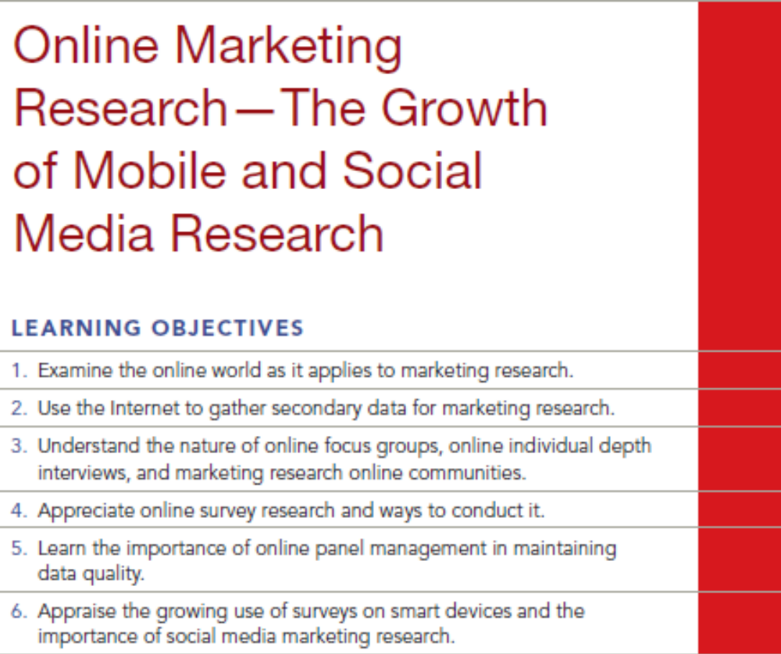
Chapter Seven Q and A
7-1

Slide 2
Question
Explain the relationship between blogs, MROC’s and marketing research

Slide 3
Answer
Blogs are a source of information that can be tracked chronologically. First, the information can be used as sources of secondary data. Second, the process can be studied as a form of observational research. For example, word-of-mouth research can be studied by following how quickly information provided by a blog disseminates into the public. However, blogs place no controls over content. There is no guarantee that the information in a blog will be of any value. MROC’s are invited blogs. The dialogue is ongoing and more “on topic.” Respondents are invited based on qualifying characteristics. There would be much less “waste” in responses from an MROC where the objectives of the ongoing dialogue are known to the respondent.

Slide 4
Question
Discuss the advantages and disadvantages of online focus groups.

Slide 5
Answer
Online focus groups are made up from databases of individuals who volunteer to participate. The databases can be screened to make up groups of individuals that meet certain criteria that are important to the research sponsor.
Benefits are the lack of geographic barriers, greater access to individuals with special characteristics, much lower cost, faster turn-around time, and (possibly) greater candor on the part of participants.
Criticisms of online focus groups are the lack of interaction between participants, difficulty in evaluating non-verbal responses, difficulty for the research sponsors to observe the group in action, a range of security and privacy issues, and problems with outside interference.
As long as the researcher and the sponsor understand these limitations it is possible to get useful information from either sort of focus group.

Slide 6
Question
Explain the difference between a traditional marketing research survey and a social media community project?

Slide 7
Answer
Much social media marketing research is different from traditional survey research. Rather than a product manager asking a research team to determine X, Y, and Z, and then have the researchers conduct the survey and provide the requested feedback, social media research is more interactive, via a few questions, and observations over time. Social media, such as Facebook, Twitter, Pinterest, and LinkedIn, give opportunities to marketing researchers to better understand their customers and potential customers. By analyzing social media exchanges about a product or service, researchers can learn what factors customers use to determine value as well as the way they speak about the product, service or brand.

Slide 8
Question
Which of the following is not characteristic of Internet surveys?
online self-administered interview
significant interviewer bias
medium to high risk concerning representativeness
purchased list of non-profiled respondents

Slide 9
Answer
Ans: B

Slide 10
Question
Which of the following are not disadvantages of traditional online focus groups?
lessened group dynamics
lack of nonverbal inputs
exposure to external stimuli less efficient
All are disadvantages of online focus groups.

Slide 11
Answer
Ans: D

Slide 12
Question
A marketing research online community (MROC) can help do which of the following?
Map the psyche of consumer segments
Brainstorm new ideas
Co-create and test new products
Observe natural consumer behavior
All of these

Slide 13
Answer
Ans: E

